Slide 1


NEXT GEN EMPLOYABILITY PROGRAM
CREATING A FUTURE-READY WORKFORCE
Student Name :
Mohammed Shah Nawaz Ahmed
Student ID :
College Name :
STU64dcd1bf10b171692193215
SR University, Warangal.

Slide 2
CAPSTONE PROJECT SHOWCASE
Project Title
Building Notes Sharing App for Academician
using Django Framework
Abstract | Problem Statement | Project Overview | Proposed Solution | Technology Used | Modelling & Results | Conclusion | Q&A

Slide 3
Abstract
1
Creating an app for sharing academic notes using Django Framework
2
Developing an user-friendly platform for faculty and students to share academic notes securely.
3
Creating an accessible platform for storing and accessing academic notes for both faculty and students anytime, anywhere.
4
By putting all the notes in one place, we'll make it easier for everyone to work together and share what they know, making learning faster and better for everyone.

Slide 4


Problem Statement
Current methods of note sharing in academia are fragmented and inefficient.
Lack of a centralized platform leads to difficulties in sharing, organizing, and accessing educational materials.
Concerns regarding the privacy and security of educational materials shared via email or cloud storage, posing risks of unauthorized access or data sensitivity.
Sharing course materials takes too long for teachers and makes it hard for students to get the right stuff on time.

Slide 5

Project Overview
Development of a web-based Notes Sharing App for Academicians.
Creating a platform where students and faculty members can easily share and access educational materials like notes and resources
Features include user authentication, file management, search capabilities, and access controls. secure sharing within academic communities.
Encouraging collaboration through comments and discussions on shared notes.

Slide 6
Proposed Solution
Creating a user-friendly platform where both students and faculty can easily share and access educational materials, ensuring seamless communication and collaboration between them.
Implementing user authentication and access controls in Django to ensure secure sharing of materials and protect sensitive data.
Incorporating search functionalities to enable users to easily find relevant materials based on keywords or categories.
Regularly updating and improving the platform based on user feedback to enhance usability and meet evolving needs.
Providing clear documentation and user guides to facilitate seamless onboarding and usage for both students and faculty members.

Slide 7
Technology used
Django Framework: Backend development and routing.
Python: Backend logic and scripting.
HTML, CSS, JavaScript: Frontend development.
Bootstrap: Responsive design and UI enhancement.
PostgreSQL: Data storage.
VS code: IDE

Slide 8
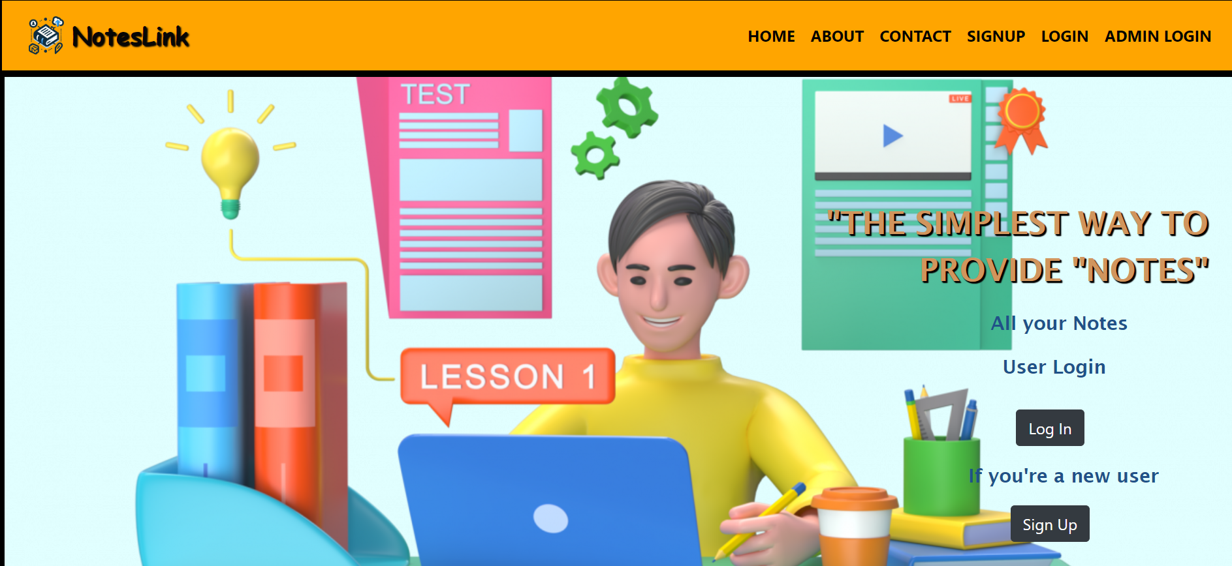
Modelling & Result
Home

Slide 9
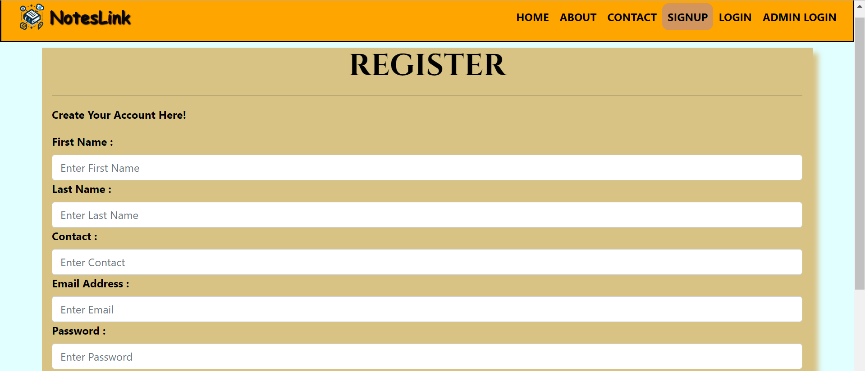
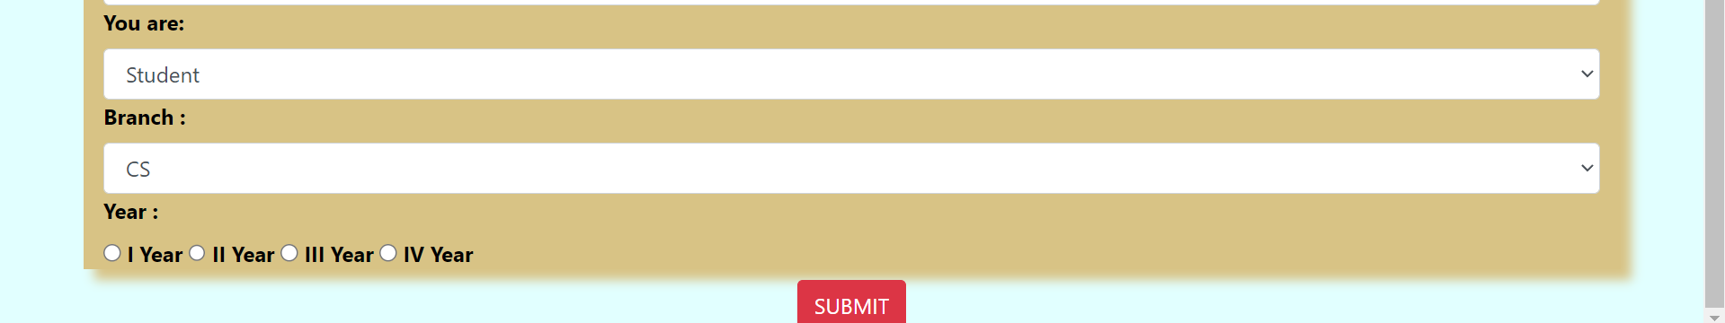
Modelling & Result
Signup (Register)

Slide 10
Modelling & Result
Login

Slide 11
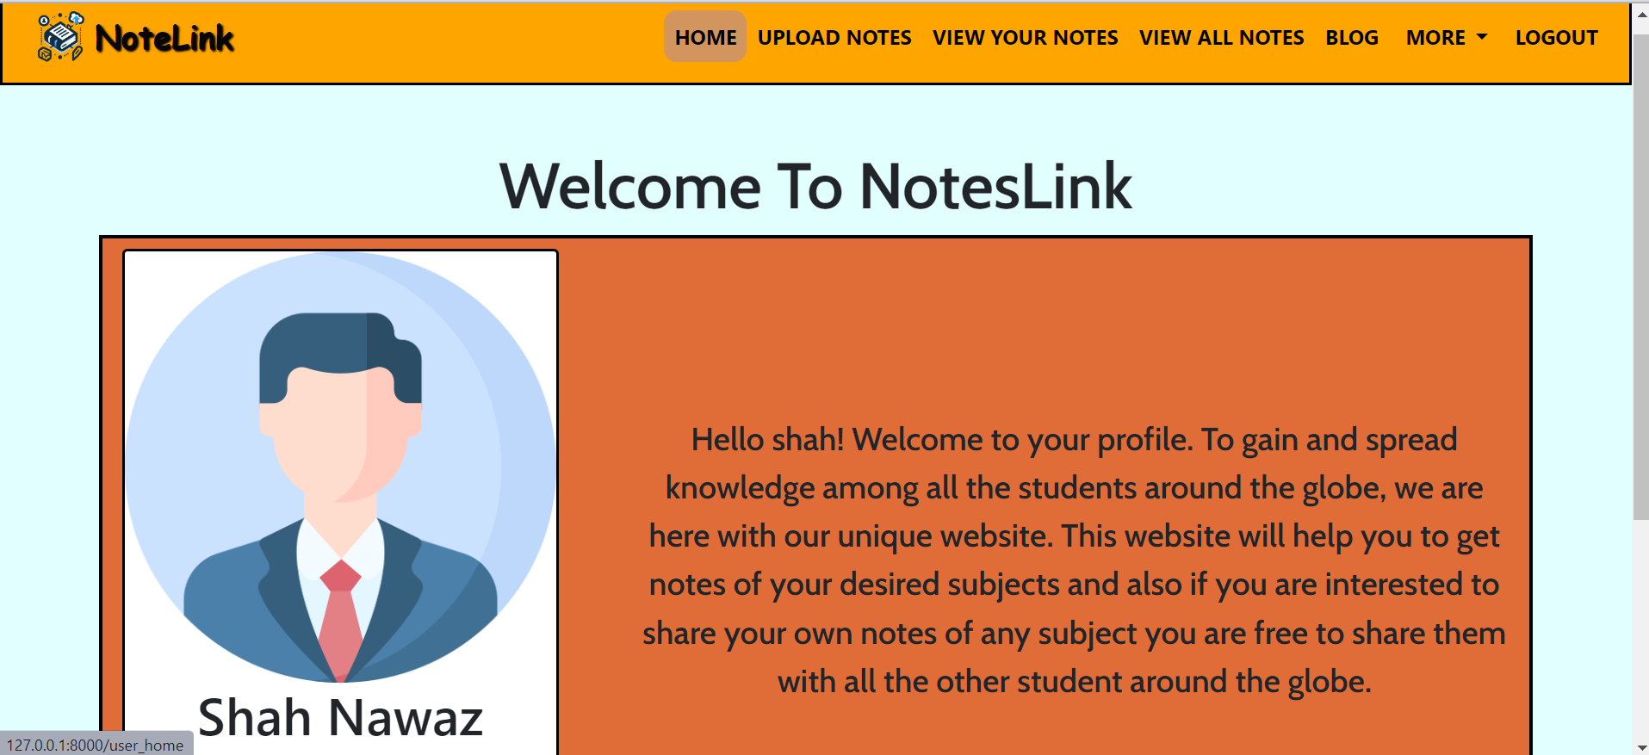
Modelling & Result
Faculty Login\\ home

Slide 12
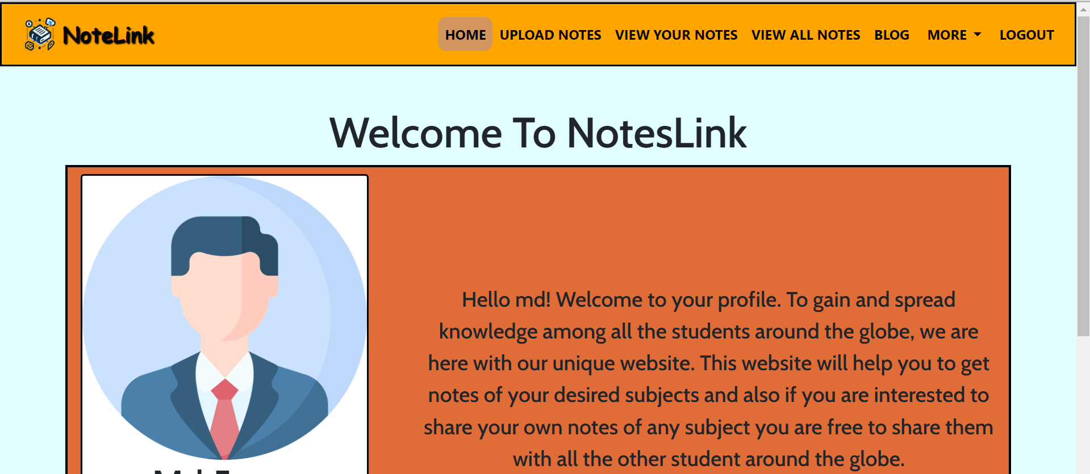
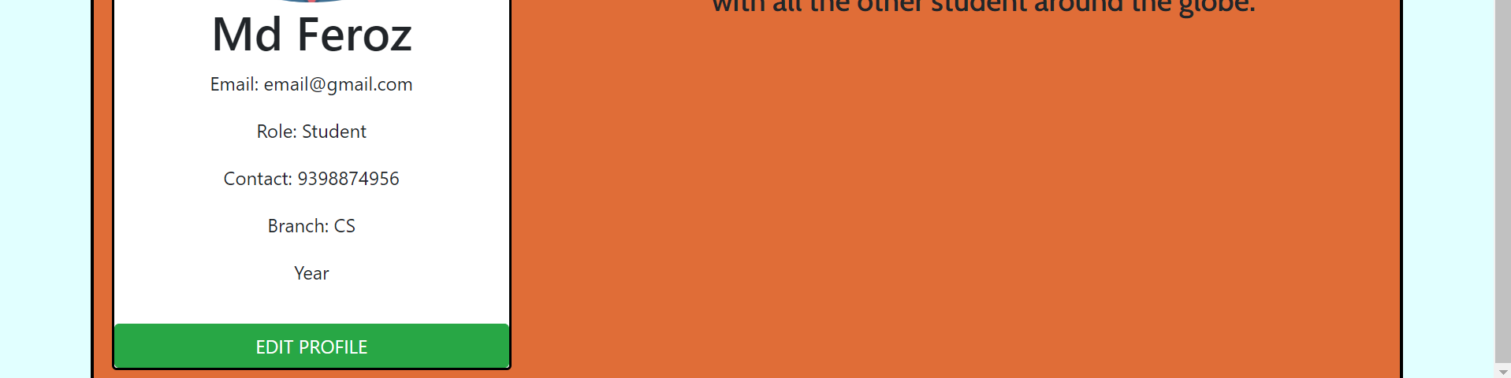
Modelling & Result
Student Login\\ Home

Slide 13
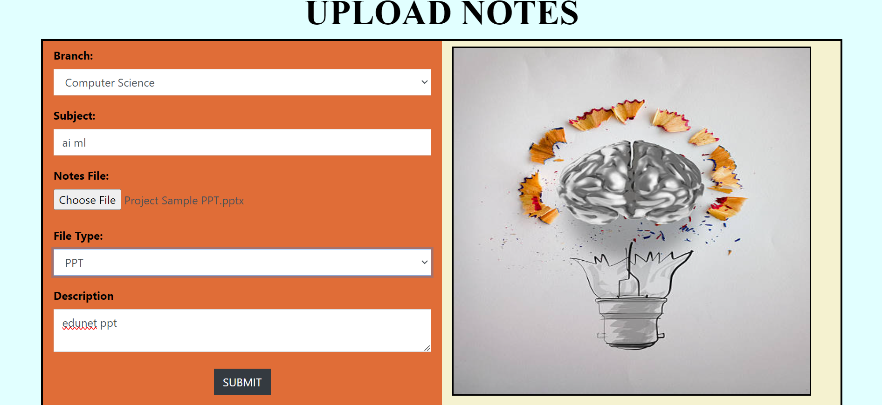
Modelling & Result
Upload Notes

Slide 14
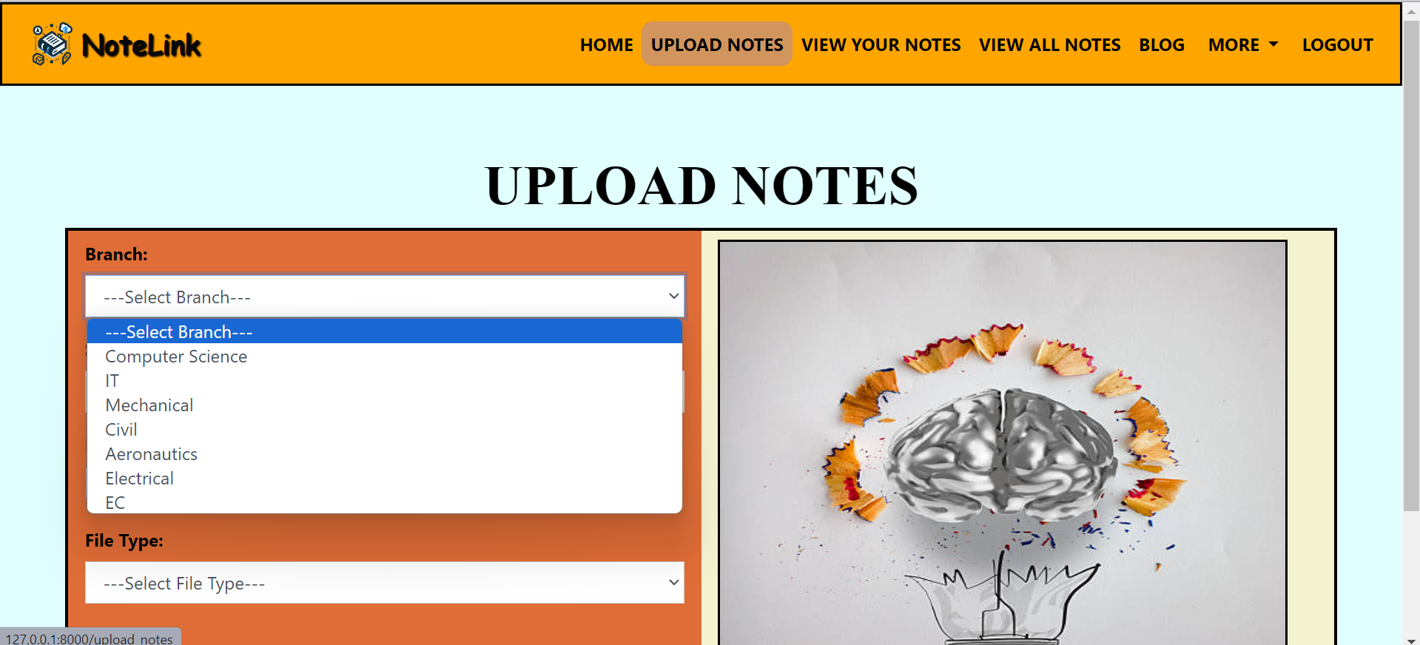
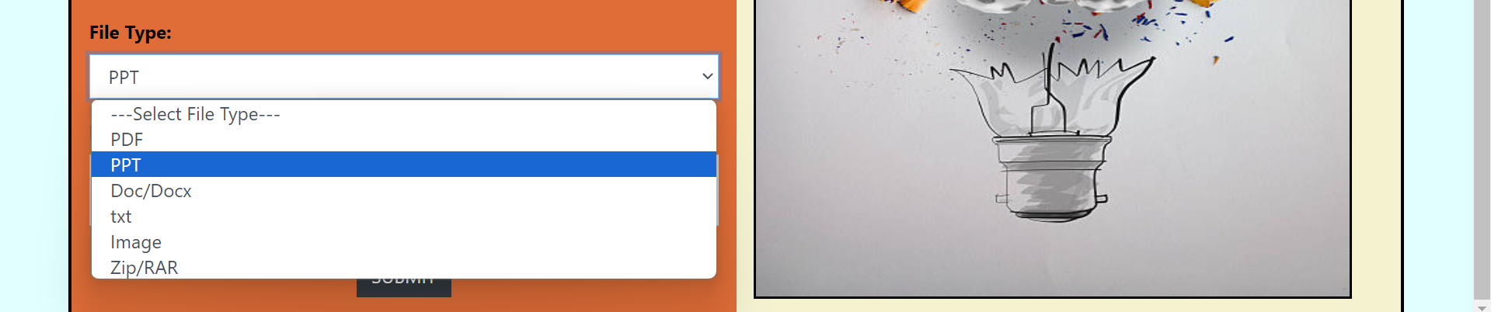
Modelling & Result
Upload Notes (Branch, File type)

Slide 15
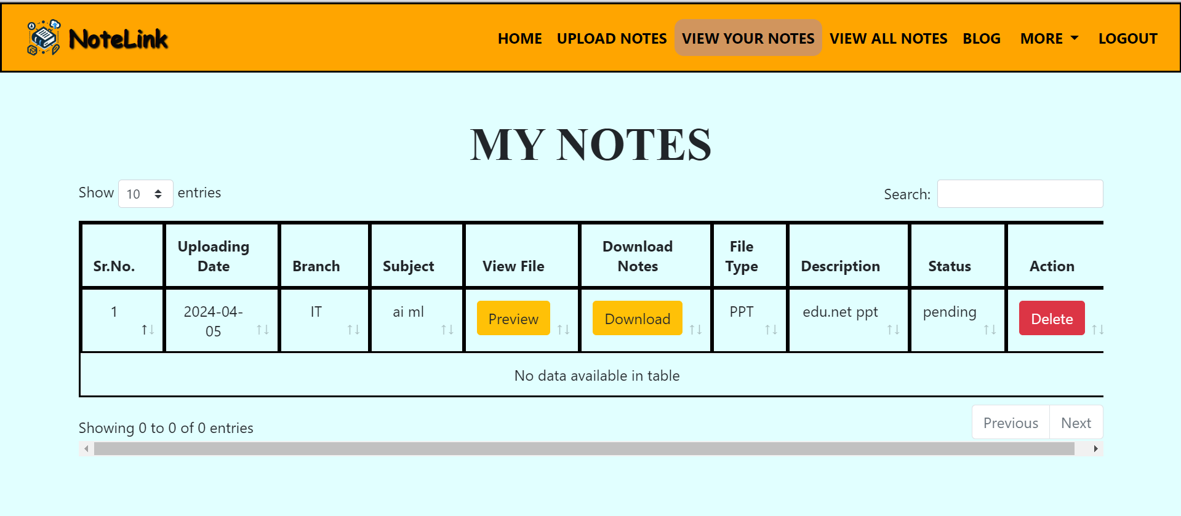
Modelling & Result
View Your Notes (Uploaded notes)

Slide 16
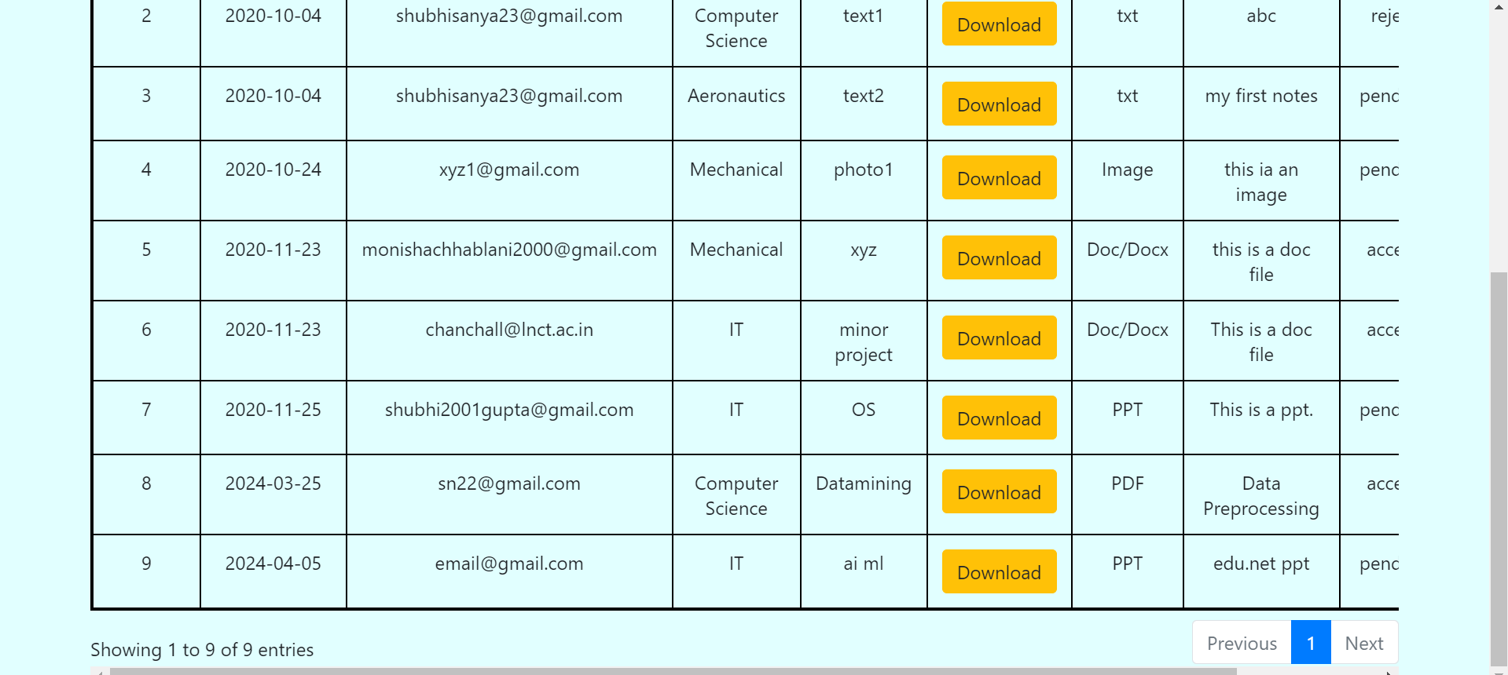
View All Notes

Slide 17
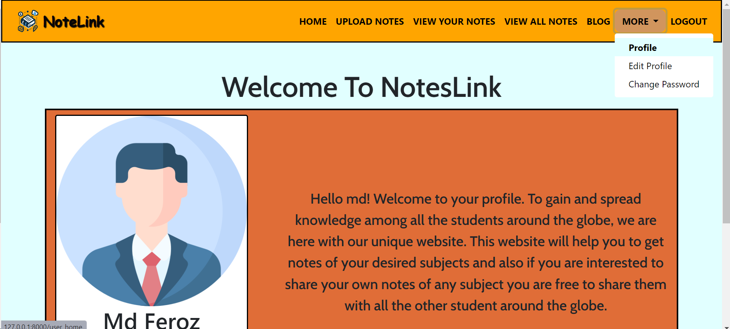
More ->

Slide 18
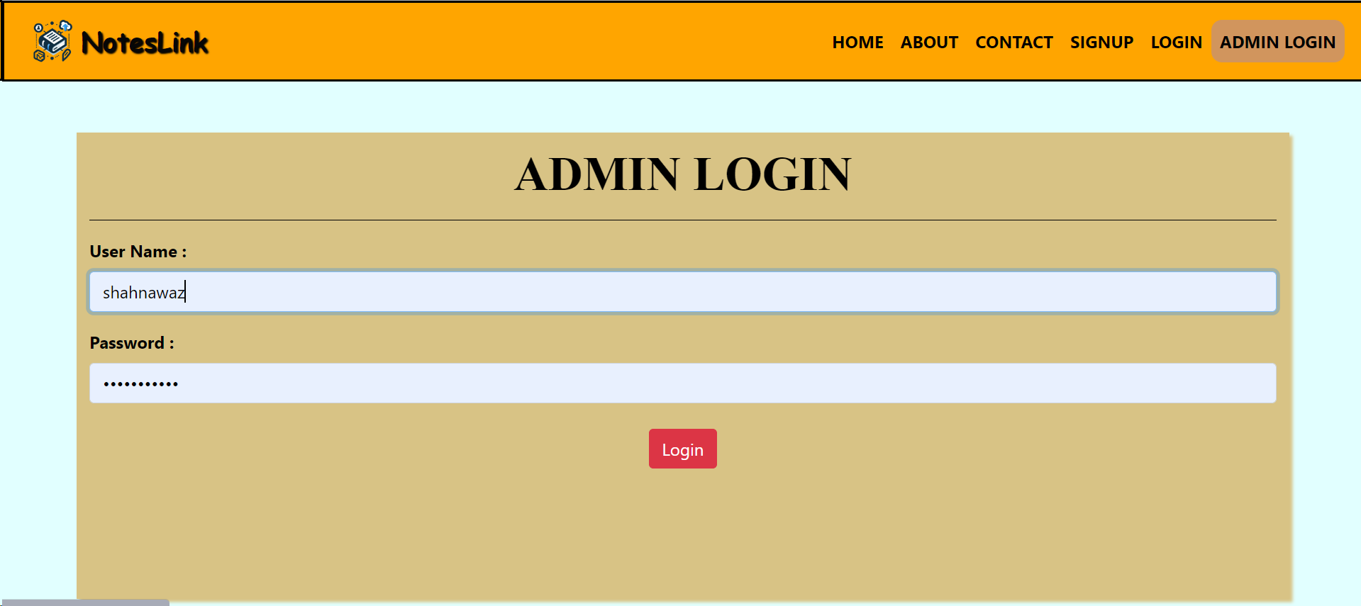
Admin Login

Slide 19
Admin Home

Slide 20
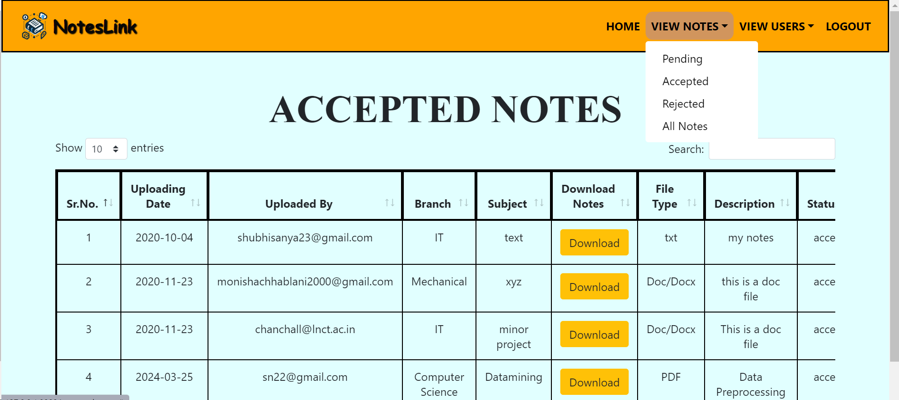
View Notes: (Pending. Accepted, Rejected, All)

Slide 21
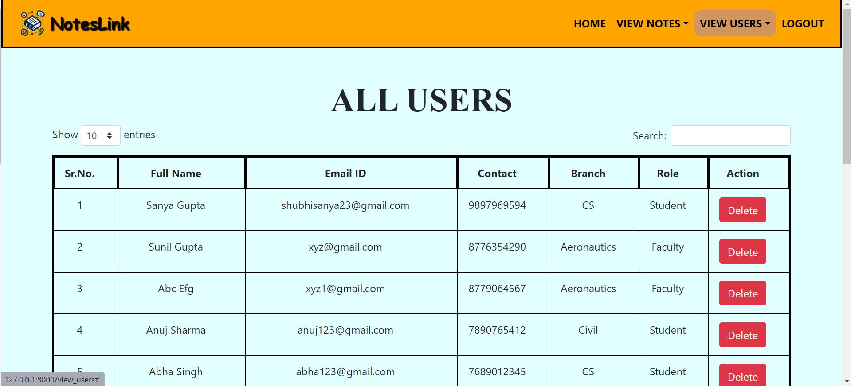
View Users
(Accept, Delete users)

Slide 22
Conclusion
Addressing the need for a centralized note-sharing platform in academia.
Implementing strong user authentication and access controls to protect educational materials, ensuring only authorized users can access and interact with the platform securely.
By centralizing note-sharing, accessibility of course materials, making it easier for students and faculty to locate and utilize resources efficiently.
Facilitating seamless collaboration between students and faculty members encourages the exchange of ideas and fosters a supportive academic community where knowledge can be shared and expanded.

Slide 23
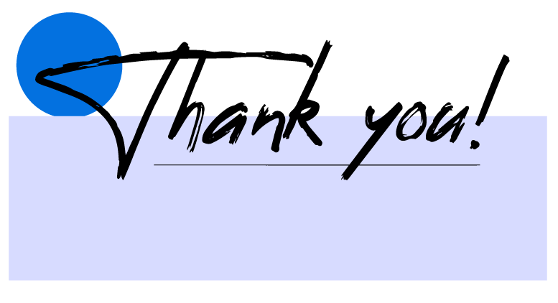

Notes:
Thank You !!

